Slide 1
SUS BIRDS
P20-0460(SYED ALI HASNAIN)
P20-0484(MUHAMMAD FAIZAN WASIF)
P20-0117(HAMZA SHAHID)

Slide 2
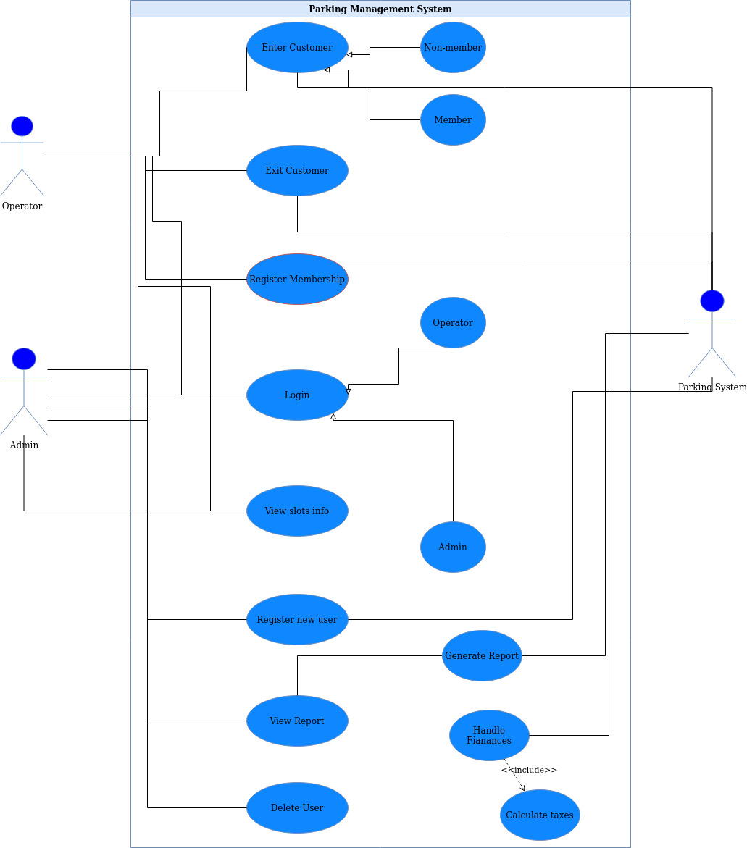
Use case

Slide 3
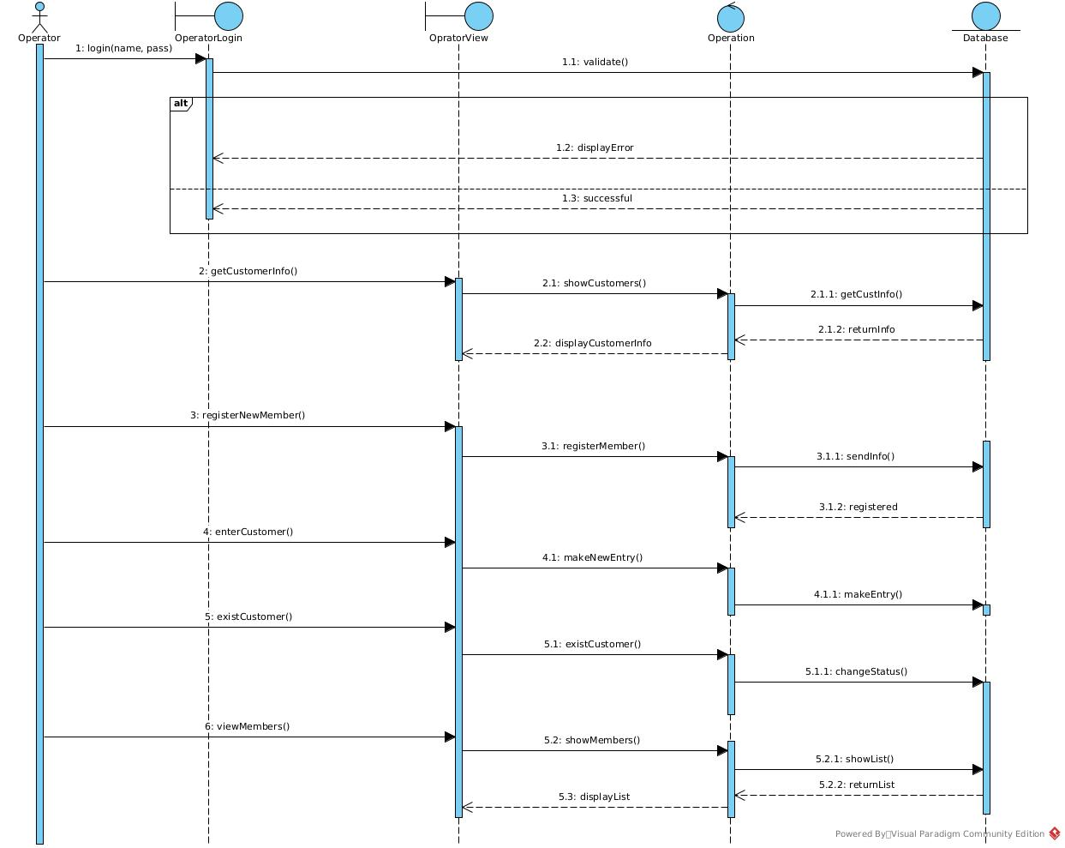
Sequence Diagram

Slide 4
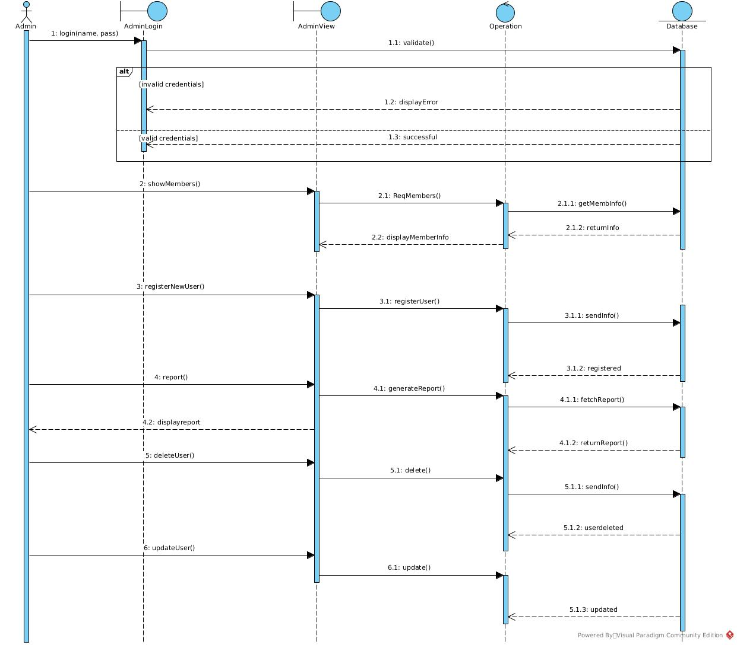
Sequence Diagram

Slide 5
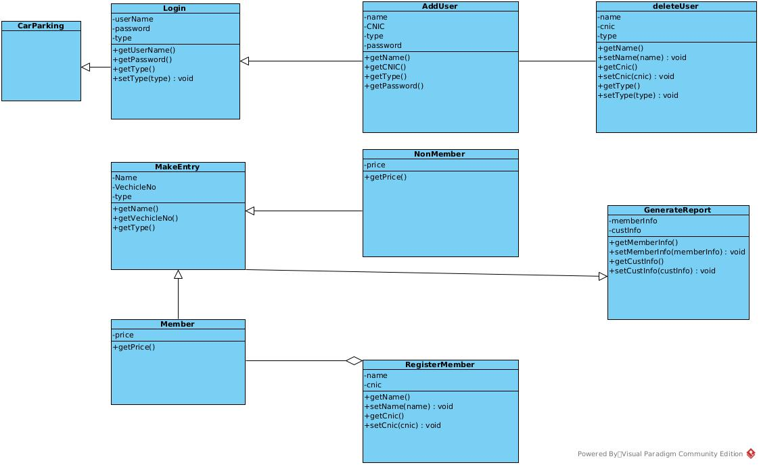
Class Diagram

